Slide 1
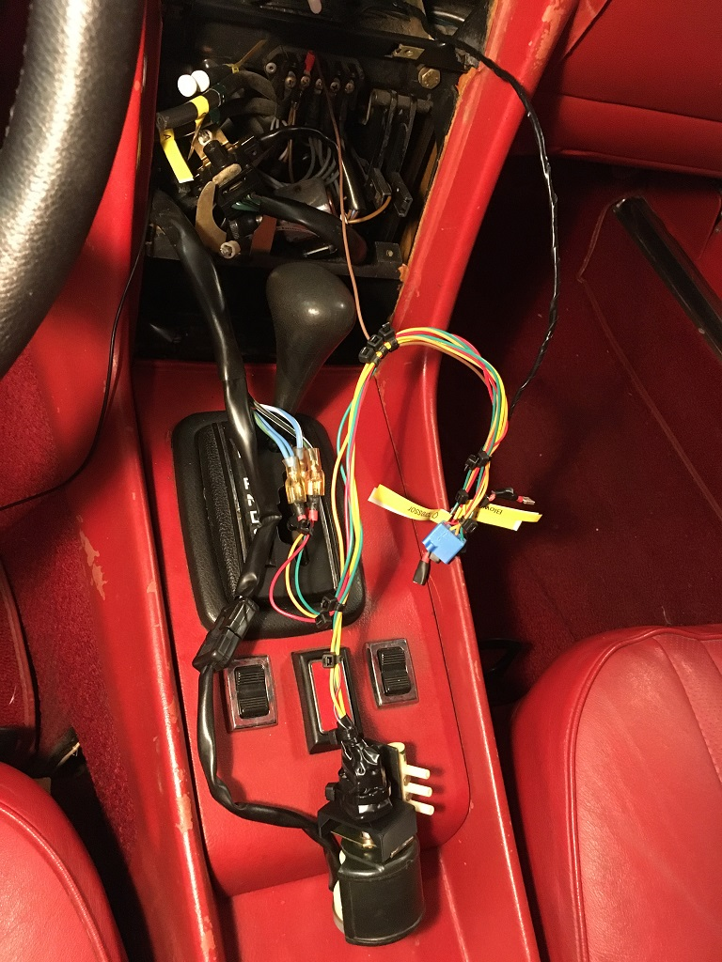
Ground wire connection
New ground wire
Thermocouple wire
Vehicle wires for 12V, compressor, blower
Connectors for circuit board
Extension wires for vehicle wires
Switch wires

